Slide 1

My Local Cooperative
Education. Community. Agriculture.

Slide 2

Get Down to Business!
You’re in business!
Go to https://bit.ly/2q4QmTu
Get into a group of 3
Enter your code (coming on a piece of paper)
Follow along!

Slide 3
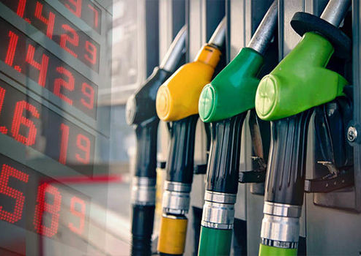
Your Business!
Scenario 1!
Time to pay at the pump – fuel prices are on the rise. This will have a direct impact on your bottom line as expenses rise.
What do you do?

Slide 4
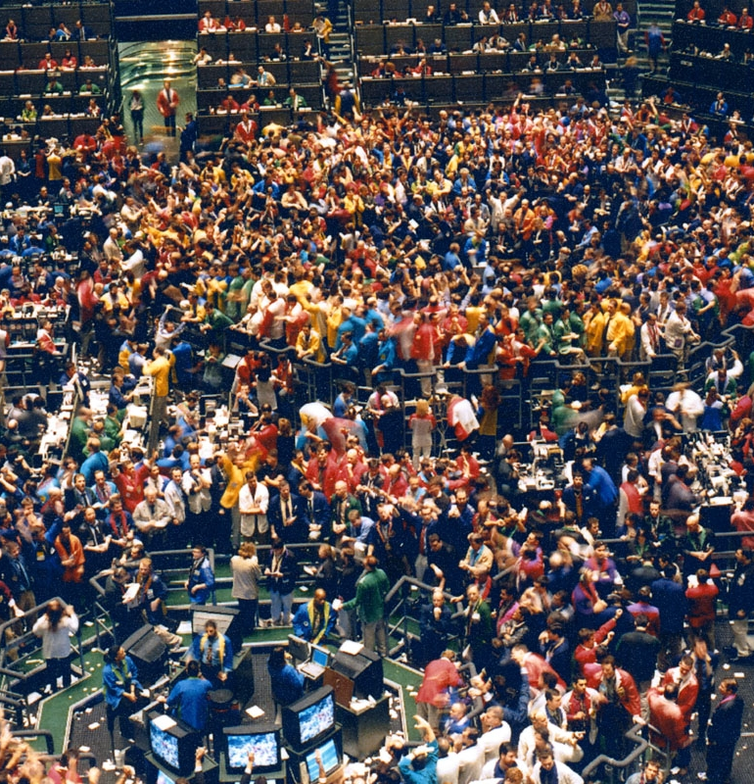
Your Business!
Scenario 2!
Trade agreements continue to be in a state of flux. As a result of the latest round of agreements, commodity prices and futures begin a roller coaster ride.
What do you do?

Slide 5

Your Business!
Scenario 3!
Businesses sometimes go through periods of transition and decision making that will very much affect their future success. Currently, the organization that is your largest vendor you purchase supplies from is considering major changes that will affect everything – timing, availability, and prices. You are not sure they are setting out on the right path.
What do you do?

Slide 6

Your Business!
Scenario 4!
A new marketing opportunity for a new processed product that is made from your crops comes out. This new market requires heavy up-front investment but could have major returns with significant profit.
What do you do?

Slide 7
Your Business!
Compare notes!
  Break up the band
  Find people who had a different business than you
    There were three:
    Happy Trails, Inc Green Acres Folly Farms
  How did it go for them? Compare and contrast what happened between your three different farms.
  What drove the differences?

Slide 8
What is an Agricultural Cooperative??
    The Types/Structure of Cooperatives
    The Seven Principles of Cooperatives

Slide 9
What is an Agricultural Cooperative?
A farm, business, or other organization which is owned and run jointly by its members, who share the profits or benefits.

Slide 10
Who Is…?
Carpet One
REI
AgriBank
Starbucks
Dairy Farmers of America
Land O’ Lakes
Ace Hardware
Chase Bank
CHS
Oglethorpe Power Corporation
Navy Federal Credit Union
CNN
Sunkist Growers
Piggly Wiggly
Welch’s
Associated Press
Home Depot
Ocean Spray
HealthPartners Inc
Organic Valley

Slide 11
Who Is NOT!
Carpet One
REI
AgriBank
Starbucks
Dairy Farmers of America
Land O’ Lakes
Ace Hardware
Chase Bank
CHS
Oglethorpe Power Corporation
Navy Federal Credit Union
CNN
Sunkist Growers
Piggly Wiggly Alabama
Welch’s
Associated Press
Home Depot
Ocean Spray
HealthPartners Inc
Organic Valley

Slide 12
Similarities and Differences
Ace Hardware VS Home Depot
Agribank VS Chase Bank
Ocean Spray VS Starbucks

Slide 13
References
Wadsworth, J and Eversull, E. (2016). Co-ops 101 an introduction to cooperatives. United States Department of Agriculture.
Cooperative identity, values & principles. (n.d.). Retrieved February 2, 2020, from https://www.ica.coop/en/cooperatives/cooperative-identity

