Slide 1


Slide 2

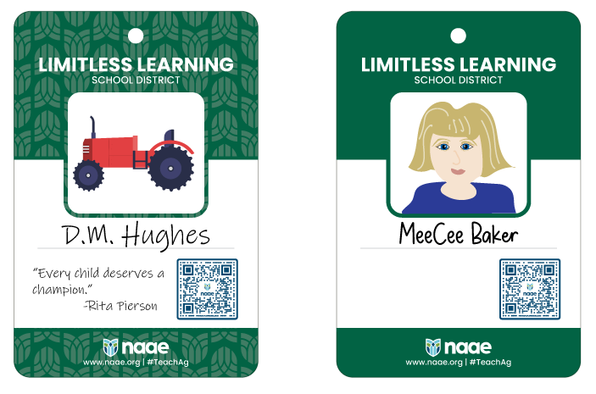
Teacher Badge Examples

Slide 3
Agricultural Education Pathways
Agribusiness Systems
Animal Systems
Biotechnology Systems
Environmental Service Systems
Food Products and Processing
Natural Resource Systems
Plant Systems
Power, Structural, and Technical Systems

Slide 4

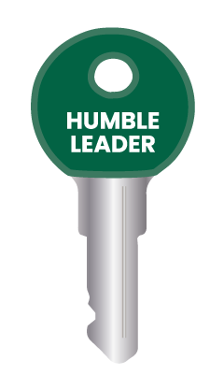
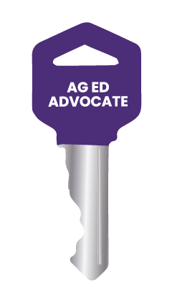
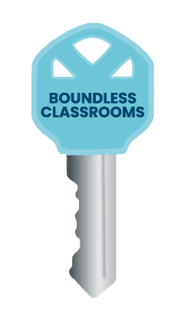
Keys for Your Lanyard

Slide 5
How to Structure an Objective
Upon completion of this ______________ (activity, lesson, field trip, project, etc.) students will ___________________ (what will students learn/gain) by ______________________ (what will students do to learn/gain that skill/knowledge).

Slide 6
Discussion Questions
What task were you impressed with that represented a different pathway that the one you selected?
After participating in the Gallery Show, would you be interested in teaching a different pathway than you selected? Explain.
Beyond the task that you completed today, what are some other tasks that you believe agriculture teachers do?
What are things that you did in this activity that you remember seeing your ag teacher do?

