Slide 1

My Local Cooperative
Cooperative Structures
Module 1

Slide 2
Cooperative Structures
Marketing
  Increase return producers receive for crops and goods
Purchasing
  Used to access affordable quality supplies
Service
  Members receive services for reasonable prices
Notes:
Cooperative businesses are structured to market, purchase, or sell products and services to its customers and patrons. Cooperatives will fit one or more of the structures.

Slide 3

Marketing
Many are agricultural
  Crop and animal production
  Forestry
  Horticulture
Negotiate prices
Combine produce for bulk sale
Process products
  Sold at local stores
This Photo by Unknown Author is licensed under CC BY-NC
Notes:
Most marketing cooperatives are agriculturally based. Market cooperatives provide members the ability to combine their resources to negotiate prices for products and sell large quantities. Some cooperatives, such as Land O’ Lakes, Sunkist, and Welches process and sell products you see at local grocery stores.

Slide 4

Purchasing
Farm inputs
  Supply access
  Feed, fuel, seed, fertilizer
Non-farm businesses
  Volume discounts
  Quality products
This Photo by Unknown Author is licensed under CC BY-ND
Notes:
Purchasing cooperatives were first started by farmers who wanted access to lower priced inputs needed for their farms. Members are able to purchase inputs, such as, feed, fuel, seed, and fertilizer for lower prices. Today non-farm businesses, such as hardware and grocery stores, use this structure for members to have access to volume discounted quality goods.

Slide 5
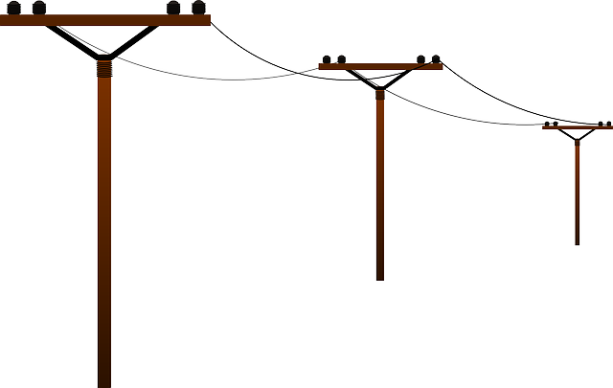
Service
Agricultural
  Input applications
  Financing
Utility
  Electric
  Telecommunications
Other
  Healthcare
  Childcare
Notes:
Service cooperatives were started by farmers needing services for applying fertilizer and pesticide inputs. Financing services are also provided through a cooperative structure. Utility cooperatives were started in rural areas needing access to electrical and telecommunication services. Other public services such as healthcare and childcare are also offered by cooperatives.

Slide 6
References
Wadsworth, J and Eversull, E. (2016). Co-ops 101 an introduction to cooperatives. United States Department of Agriculture.

