Slide 1

Careers in Agricultural Cooperatives
EDUCATION. COMMUNITY. AGRICULTURE.

Slide 2
Wall Quiz!
Grab
Grab some dots and two post-its
Visit
Visit each poster
Leave
Leave a dot or post-it

Slide 3

That’s Me!
Review the following statements/qualities.
Choose your top five that apply to you and record each onto a different post-it!

Slide 4
That’s Me!
I enjoy working with others
I want every day to be new and exciting
I like to travel
I want to help solve global hunger
I want to work with the latest agriculture technology
I enjoy helping others succeed
I want to create goals and achieve success
I want to share my creative spirit
I want to be a role model in the community
I like to solve problems
I want a career that makes a difference in the lives of others

Slide 5
Who Is…?
Carpet One
REI
AgriBank
Starbucks
Dairy Farmers of America
Land O’ Lakes
Ace Hardware
Chase Bank
CHS
Oglethorpe Power Corporation
Navy Federal Credit Union
CNN
Sunkist Growers
Piggly Wiggly
Welch’s
Associated Press
Home Depot
Ocean Spray
HealthPartners Inc
Organic Valley

Slide 6
Who Is NOT!
Carpet One
REI
AgriBank
Starbucks
Dairy Farmers of America
Land O’ Lakes
Ace Hardware
Chase Bank
CHS
Oglethorpe Power Corporation
Navy Federal Credit Union
CNN
Sunkist Growers
Piggly Wiggly Alabama
Welch’s
Associated Press
Home Depot
Ocean Spray
HealthPartners Inc
Organic Valley

Slide 7






Slide 8
Career Connections!
Land O’ Lakes:
https://careers.landolakesinc.com/us/en/land-o-lakes-jobs
Sunkist Growers
https://www.sunkist.com/careers/
Welch’s Growers:
https://welchs.applicantpro.com/jobs/
CHS Inc:
https://www.chsinc.com/careers
Ocean Spray:
https://oceansprayjobs.com/

Slide 9

Stronger Together
Notes:
https://www.youtube.com/watch?v=jPXtwWK4lkc

Slide 10
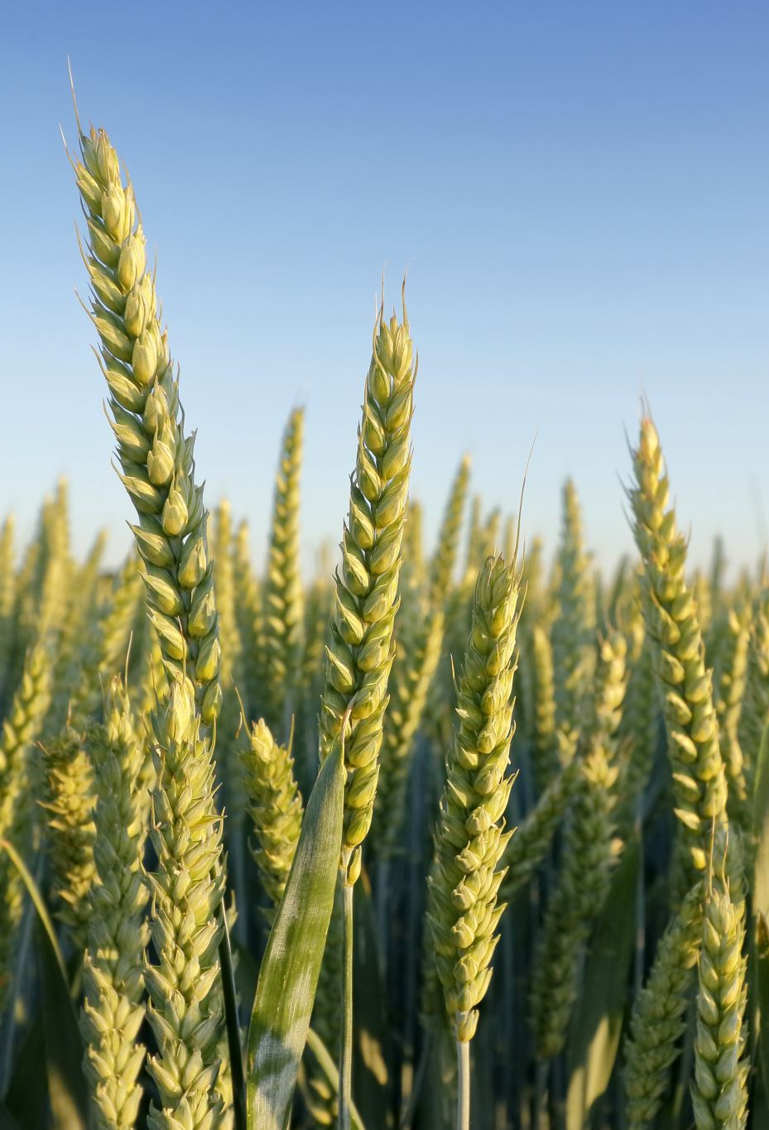
Reflection
What is the importance of agriculture in the world today?
How could being part of an agricultural cooperative allow you to be part of impact of agriculture?

